Slide 1
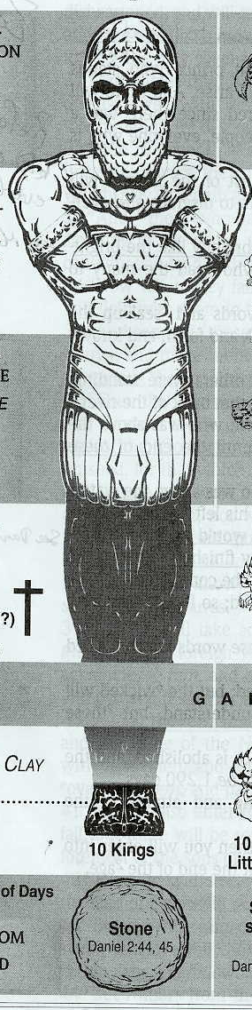
B12 WORKSHEET: PROPHETIC VISIONS OF DANIEL
Daniel 2 – Dream | Daniel 2 – Interpretation | Daniel 7 – 4 Great Beasts | Daniel 8 – Ram and Goat | Daniel 9 – 70 Sevens | Daniel 11-12
Dan 2:32 | Dan 2:37-38 | Beast 1
Dan 2:32 | Dan 2:39 | Beast 2 | Ram
Dan 2:32 | Dan 2:39 | Beast 3 | Goat
Dan 2:33 | Dan 2:40-43 | Beast 4 10 Horns Little Horn
Dan 2:34-35 | Dan 2:44-45 | Ancient of Days

